Slide 1
Enhancing Inorganic Uptake in Synechococcus sp. PCC 7002
Gavin Steeber
04/13/2019

Slide 2
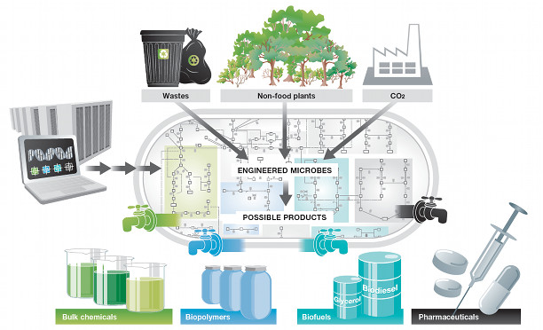
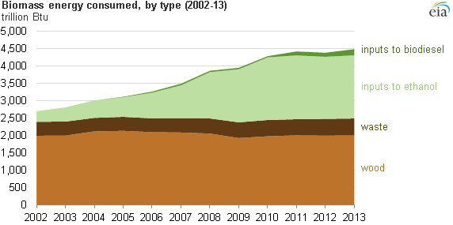
Sustainable Chemical Production – Bioprocess Engineering
Energy Production – need for sustainable resources
  Nearly 80% U.S. energy relies on non-renewable resources
Biomass sourced energy has increased by 60% over last 5 years – growth
(Nielsen Lab 2019)
Non-Renewable Product Synthesis
  S ($) →→→→→ P ($$$)
  Raw Materials (Oil, Natural Gas, metals & Ores)
Renewable Product Synthesis
  S ($$) →→→→→ P ($$$$$)
  Raw Materials (Biomass sugars, lignocellulose, CO2+light)
(Eia.gov 2019)

Slide 3
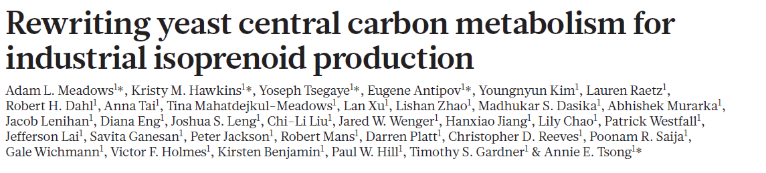

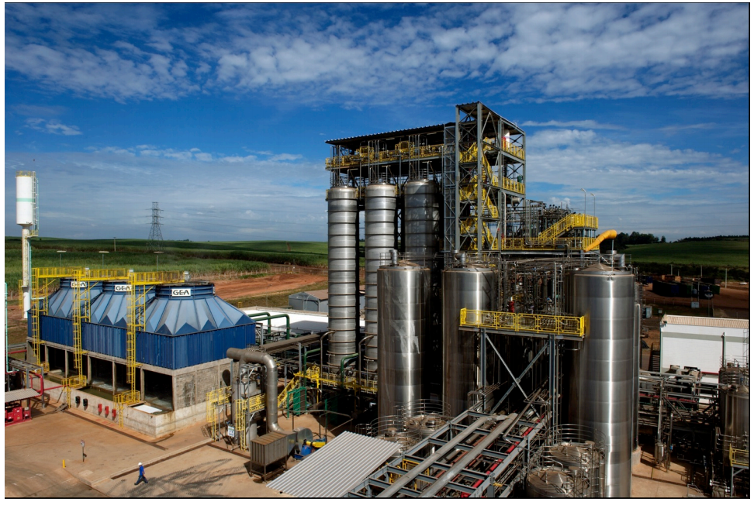
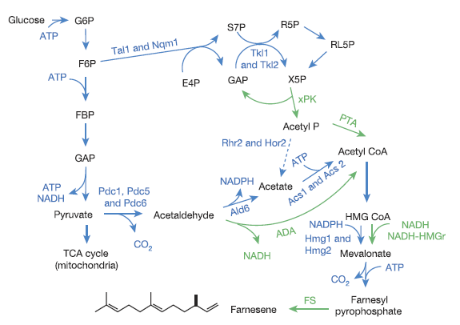
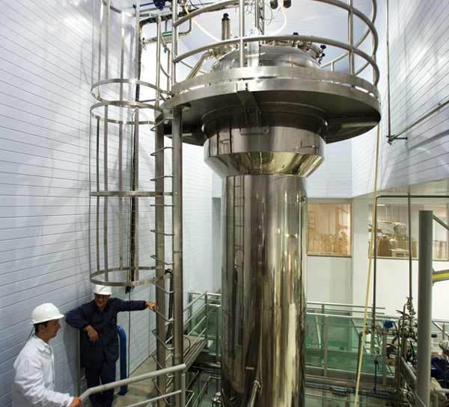
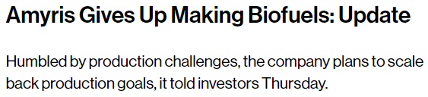
Industrial Biofuel Production – Current Process

Slide 4
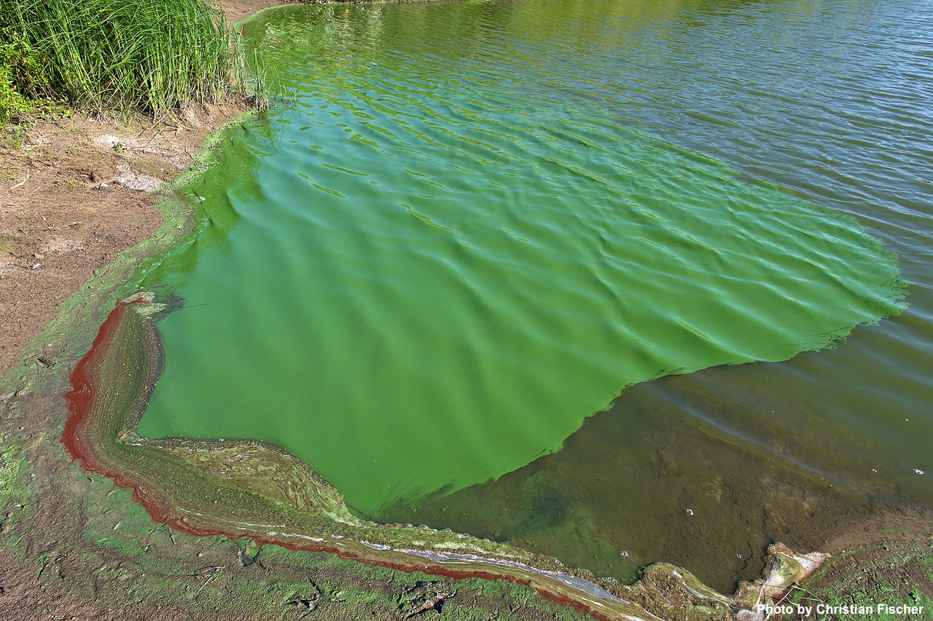
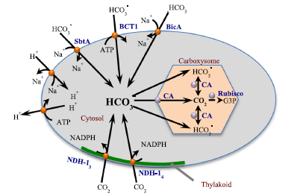
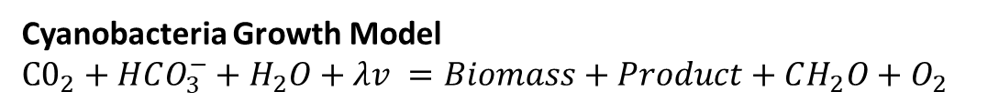
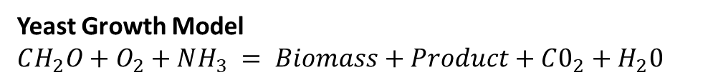
Increasing the Success in Biofuel Production using Cyano’s
Yeast Growth Model
$$CH_{2}O+O_{2}+NH_{3} = Biomass+Product+C0_{2}+H_{2}0$$
Cyanobacteria Growth Model
$$C0_{2}+HCO_{3}^{−}+H_{2}O+λv =Biomass+Product+CH_{2}O+O_{2}$$
Pros
  Produce sugars used for Bioethanol production without using arable (sugar cane fields)
  Alleviate Food or Fuel argument
  Cheap, substrates are readily available
Caveats
  Inefficient for large scale production
  Cells want to grow for themselves, not work for us
  Separation process needs improvement
N.A. Kamennaya et al.

Slide 5

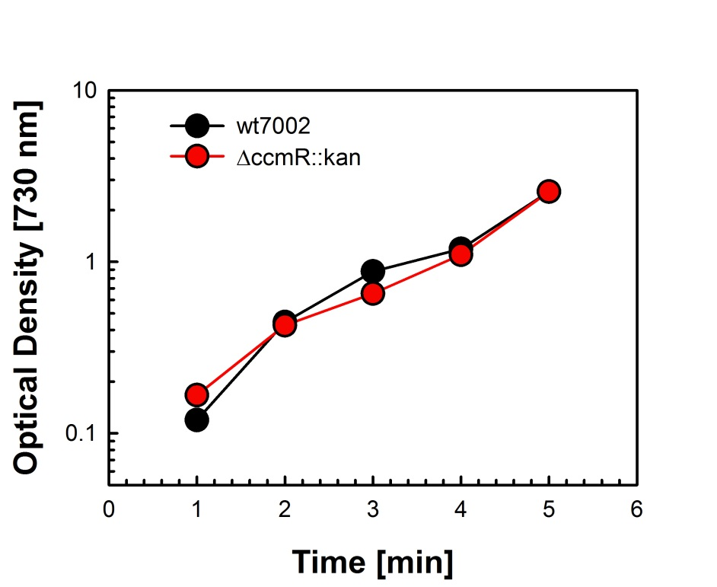
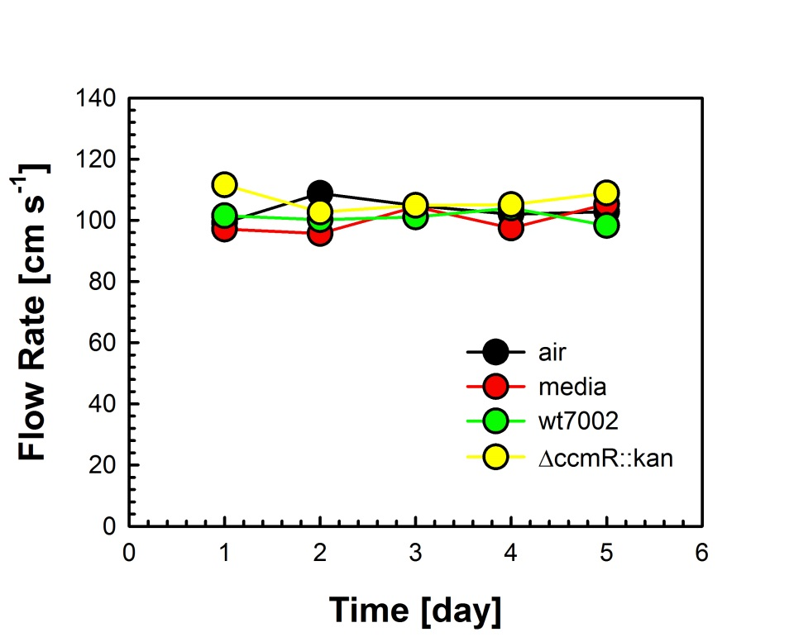
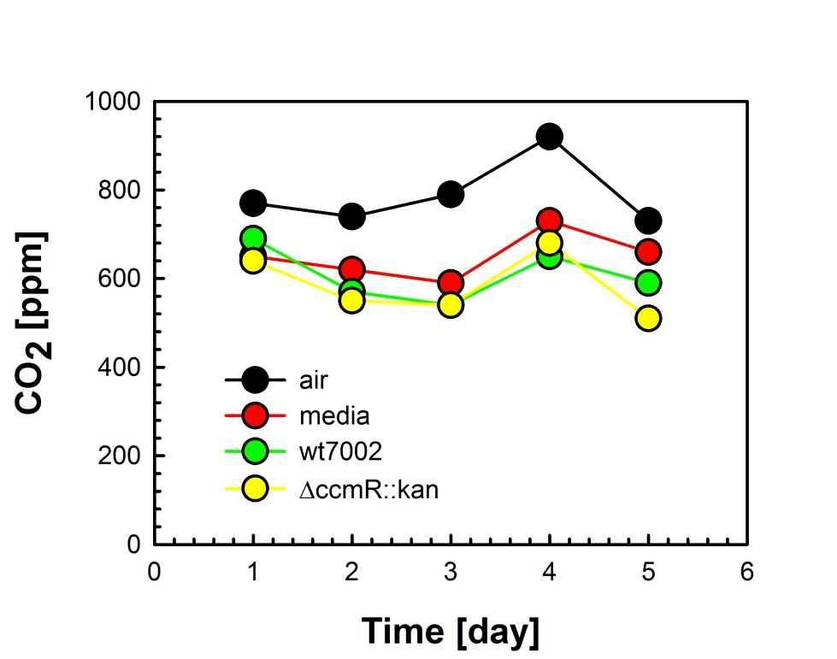


Sustainability – More than One Benefit
Applications within NASA and space exploration
  $\text{C}{\text{O}}_{\text{2}}$ capture
    Conversion to useful products

Slide 6
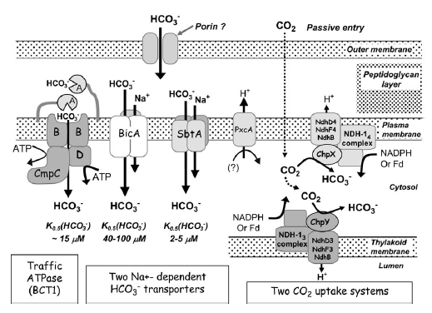
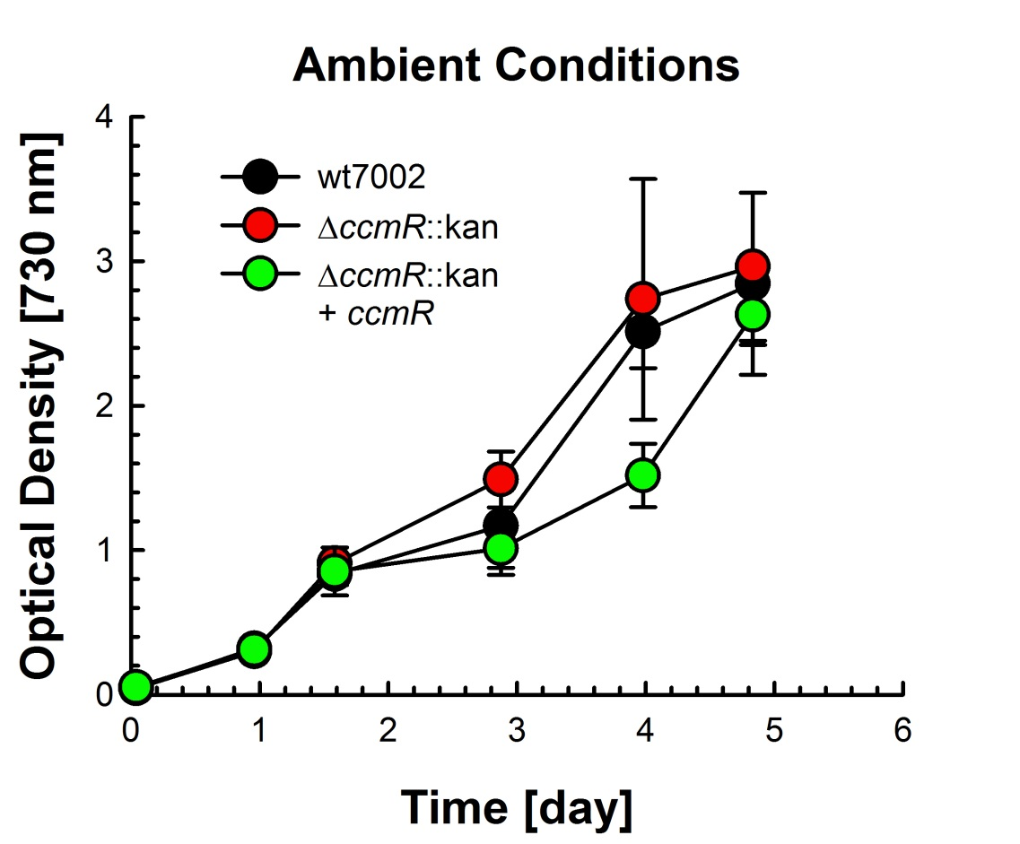
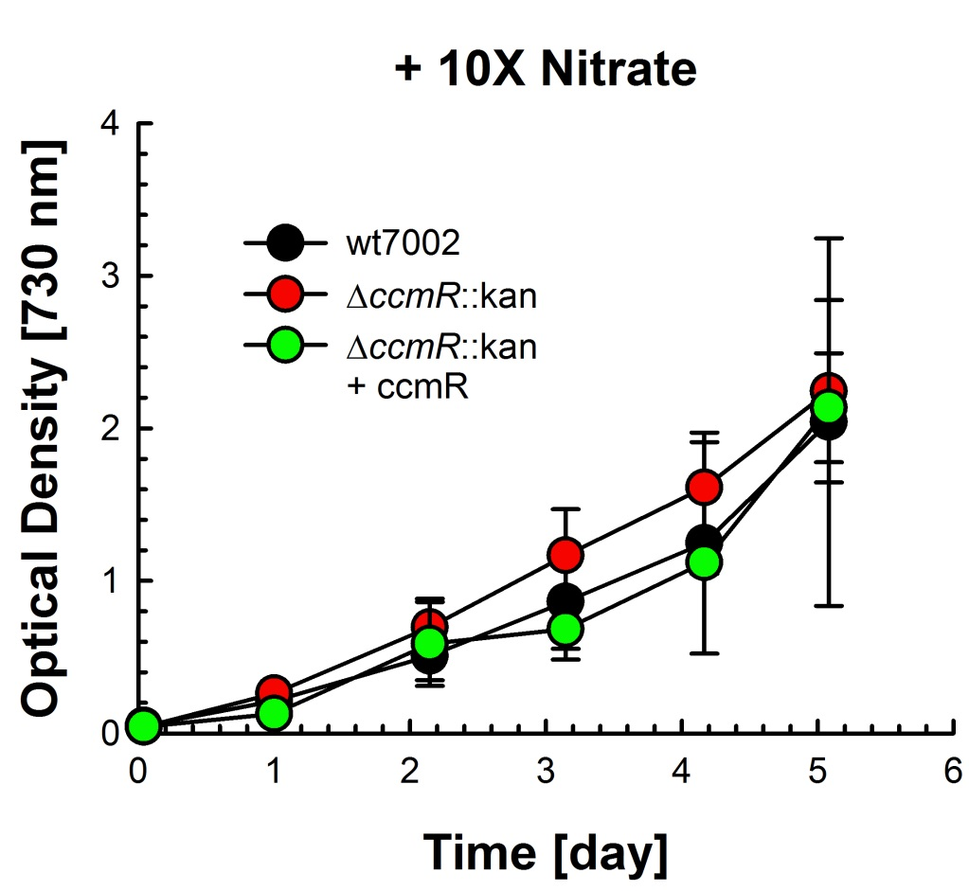
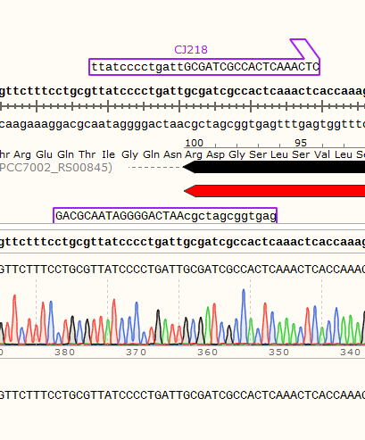
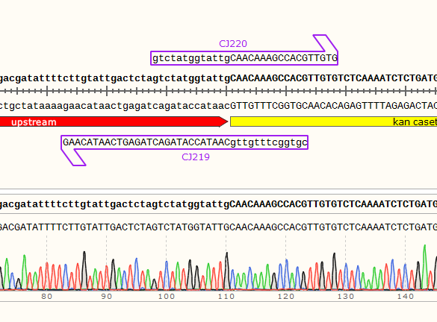
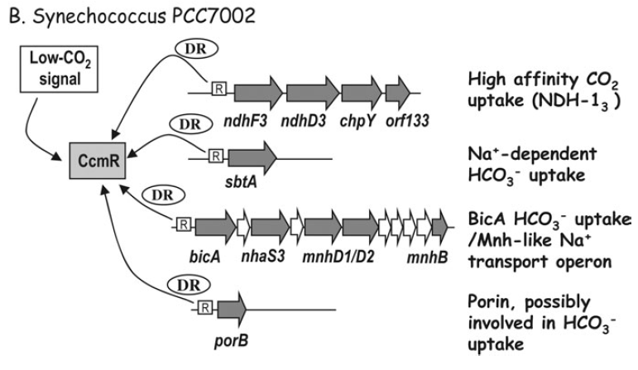
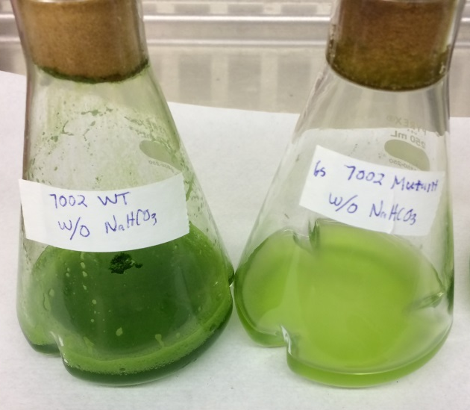
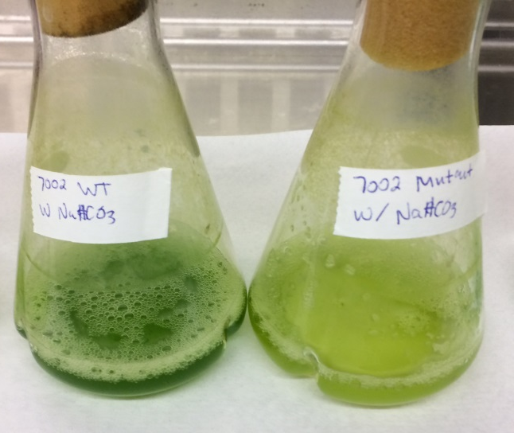
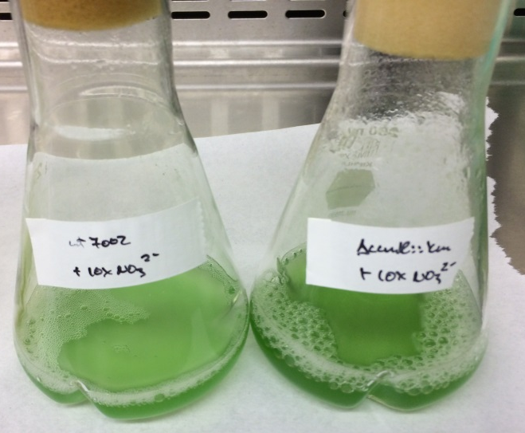
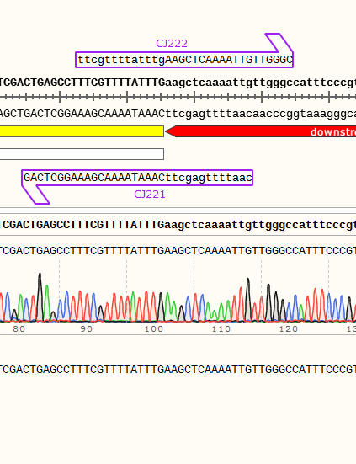
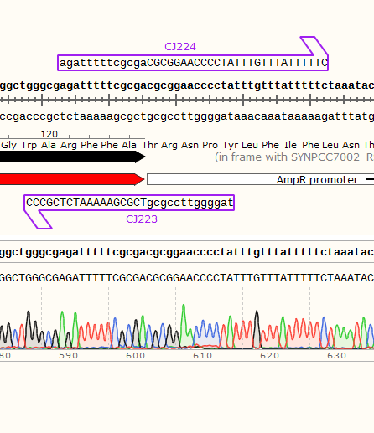
Nitty Gritty, Technical Fun
Caveats
  Inefficient for large scale production
  Cells want to grow for themselves, not work for us
  Separation process needs improvement
Ambient Conditions
+ 10 mM NaHCO₃
+ 10 g/L NaNO₃
A
B
wt
ΔccmR::kan
wt
ΔccmR::kan
wt
ΔccmR::kan
C
D
Price et. al J. Exp. Bot. 59:1441 (2008)
n=3, 100 μE, 38ºC, 200 rpm

Slide 7
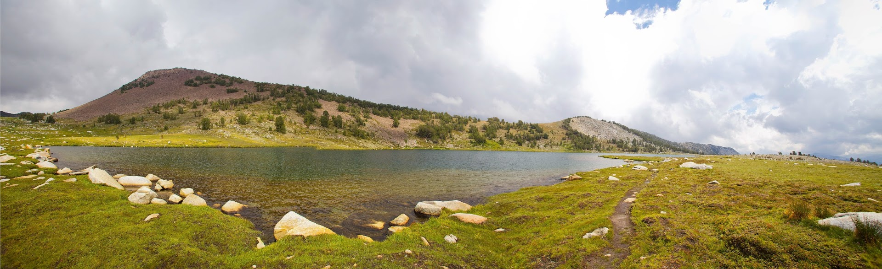

Conclusions/Questions
Shown an increase in cell growth efficiency →→→→ More product made ($$)
Shown increase to $\text{C}{\text{O}}_{\text{2}}$ →→→→ Sustainable space usage

